Slide 1
Week 3

Slide 2
Introduction:
In this presentation, we showcase our use of forecasting in Tableau to analyze and predict trends over a two-month
period. By leveraging Tableau’s advanced forecasting
techniques, we generated insightful visualizations to identify patterns and make data-driven decisions. Our approach focuses on utilizing historical data to create accurate short-term forecasts, helping to enhance strategic planning and performance evaluation.

Slide 3
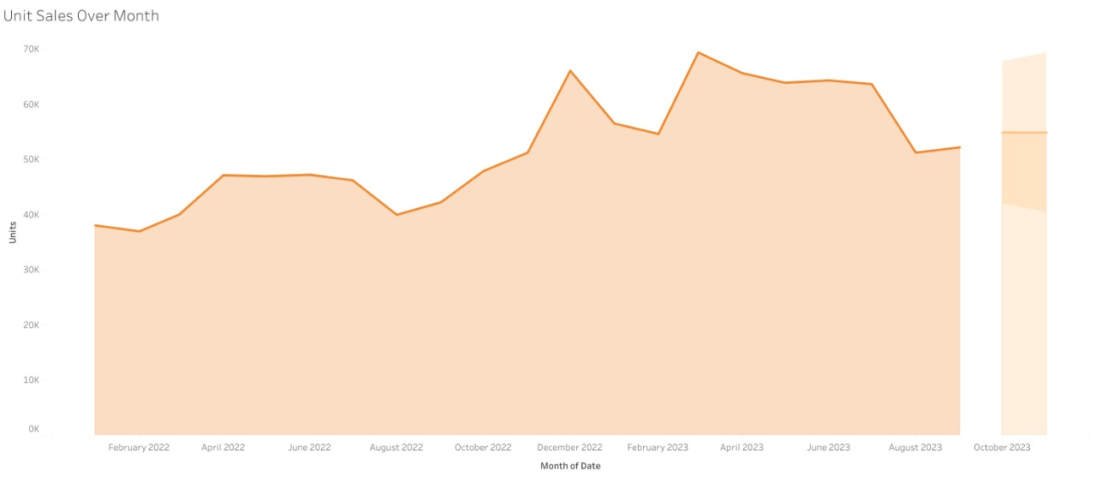
Q1:what is the forecasted unit sales for the next two months (October and November 2023)? Additionally, what is the expected percentage increase or decrease in unit sales compared to the last month (September 2023)?
Result: The forecasting shows increasing by 5.2% in unit sales comparing to the last month (September).

Slide 4
Q2:What is the forecasted revenue for the top 5 best-selling products for the next two months(October and November ,2023)?
Results: Lego bricks The forecasting shows increasing (15.7%) in October and November 2023 comparing to September 2023 (the previous month).
Magic Sand The forecasting shows increasing (7.18%) in October and November 2023 comparing to September 2023 (the previous month)
Color buds The forecasting shows increasing (8.6%) in October and (4.7%) in November 2023 comparing to September 2023 (the previous month).
Rubik's cube The forecasting shows increasing (22%) in October and November 2023 comparing to September 2023 (the previous month).
Action Figure The forecasting shows increasing (7.4%) in October and November 2023 comparing to September 2023 (the previous month).

Slide 5
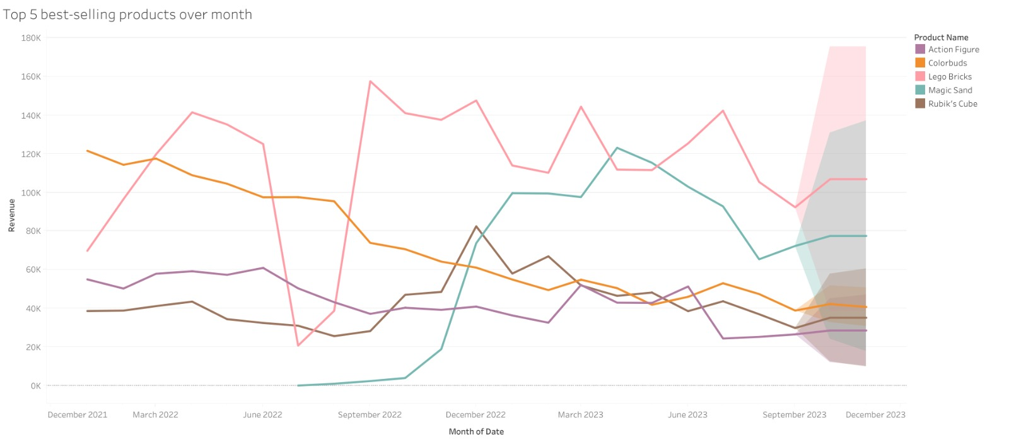

Slide 6
Q3: Question: How does revenue vary between store
locations over time, and what is the forecasted revenue growth for
the next two months?
Result: Forecasted revenue increases from September to October/November are approximately 1.74% for Residential, 4.51% for Downtown, 8.40% for Commercial, and 23.21% for Airport locations.
Conclusion : This analysis highlights that although all locations are growing, the Airport location shows a significant increase, indicating a potential focus area for strategic investments and resource allocation.

Slide 7
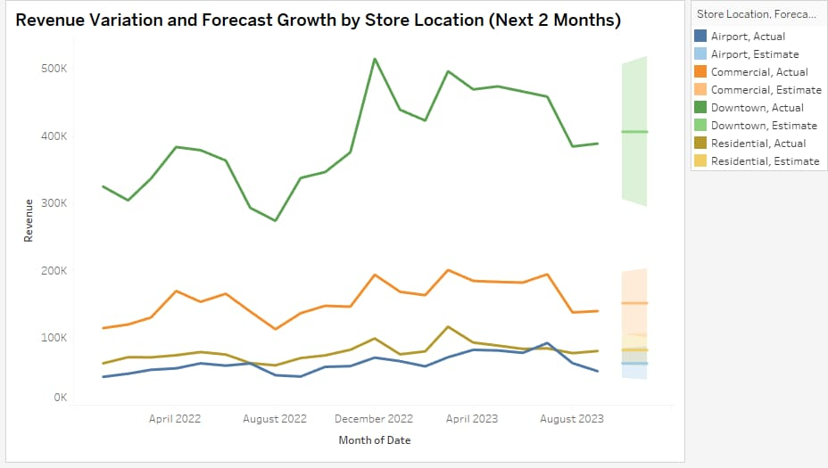

Slide 8
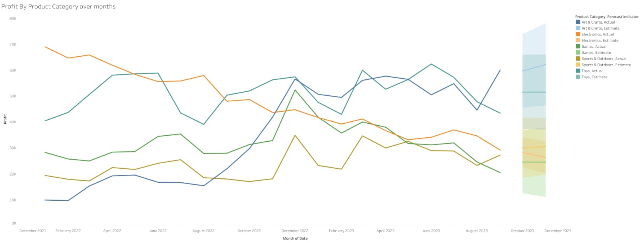
Based on Row data of unit sales and Profit over time
Q4:How do Profit change according to Product Category in the months?
Answer: Profit changes based on unit sales Arts & Crafts Forecast on October 2023, Profit is 0.61% lower than September 2023Sports & outdoors Forecast on October 2023, Profit is 10.13% higher than September 2023GamesForecast on October 2023, Profit is 19.67% higher than September 2023Electronics Forecast on October 2023, Profit is 3.21% lower than September 2023ToysForecast on October 2023, Profit is 18.68% higher than September 2023

Slide 9
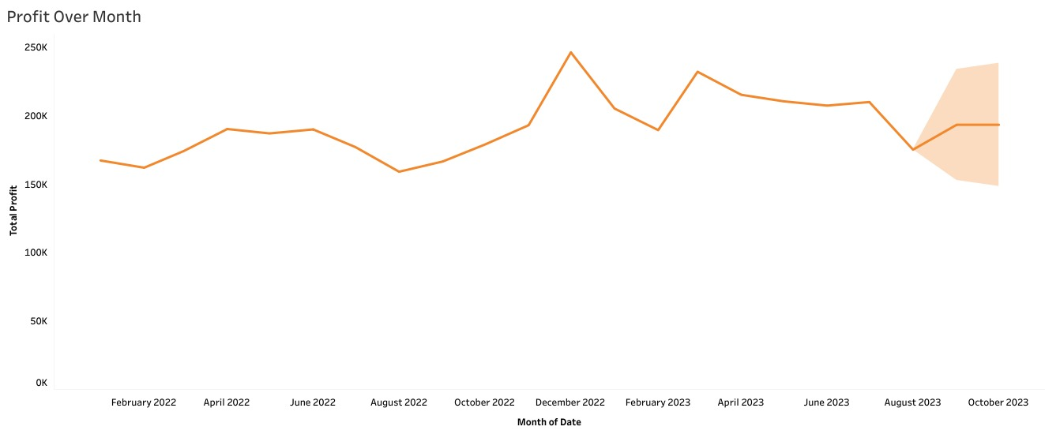
Based on the historical data of total profit over time.
Q5:what is the forecasted total profit for the next two months (October &November 2023)?
Results: The forecast shows an increase of 3.3% in total profit compared to the last month (September 2023).

